Slide 1
1- Comparison Operators

Slide 2

we usecomparison operators to compare values.
what we have here is a Boolean expression, because when this expression is evaluated, we'll get a boolean value that is True or False.

Slide 3
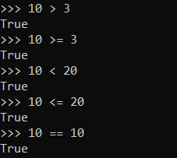

Slide 4

We get False, because these values have different types and they're storeddifferently in the computer's memory.

Slide 5

The not equal operator

Slide 6

We can also use this comparison operators with strings.
We get True because when we sort these two words back comes after, So it's considered greater.

Slide 7


every character you see here has a numeric representation in programing.
ord
  A built in function
  Show the numeric representation of the letter

